Slide 1

CSE 473: Pattern Recognition

Slide 2
Non-Linear Classifier

Slide 3
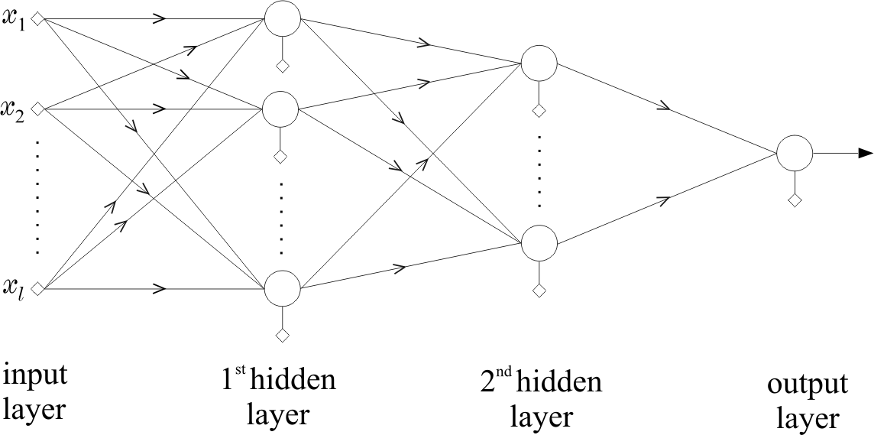
Training of a Multi Layer Perceptron (MLP)
use rationale and develop a structure that classifies correctly all the training patterns.
OR
choose a structure and compute the synaptic weights to optimize a cost function.
(L-1)^{th}
Lth or

Slide 4
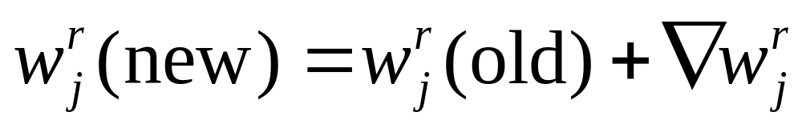
Iterative update of Synaptic weights: The Backpropagation Algorithm
computes the weights iteratively, subject to a cost function is optimized
(L-1)^{th}
Lth or

Slide 5
Iterative update of Synaptic weights: The Backpropagation Algorithm
Assume:
Multiple layers
more than one neurons in each layer
any number of classes
(L-1)^{th}
Lth or

Slide 6
Iterative update of Synaptic weights: The Backpropagation Algorithm
(L-1)^{th}
Lth or
Input vectors applied here
Estimated Outputs, one for each class

Slide 7
Iterative update of Synaptic weights: The Backpropagation Algorithm
means a single pattern
assumes a single neuron will be activated
(L-1)^{th}
Lth or
Input vectors applied here
Estimated Outputs, one for each class

Slide 8
Iterative update of Synaptic weights: The Backpropagation Algorithm
Let:
Data set has 4 classes
Training Sample# | Class#
Sample#1 | 1
Sample#2 | 3
Sample#3 | 2
Sample#4 | 4
Sample#5 | 2

Slide 9
Iterative update of Synaptic weights: The Backpropagation Algorithm
Let:
Data set has 4 classes
Training Sample# | Class# | Class Vector
Sample#1 | 1 | 1 0 0 0
Sample#2 | 3 | 0 0 1 0
Sample#3 | 2 | 0 1 0 0
Sample#4 | 4 | 0 0 0 1
Sample#5 | 2 | 0 1 0 0

Slide 10

The Backpropagation Algorithm
Recall the perceptron algorithm:
  We update with this

Slide 11
The Backpropagation Algorithm
Recall the perceptron algorithm:
  We update with this
Backpropagation updates multiple nodes for a number of layers:

Slide 12
The Backpropagation Algorithm
Recall the perceptron algorithm:
  We update with this
Backpropagation updates multiple nodes for a number of layers:
r-th layer
j-th neuron

Slide 13

The Backpropagation Algorithm
Another difference is the activation function:
Perceptron algorithm uses unit activation function:
  This function is not differentiable at x=0.

Slide 14
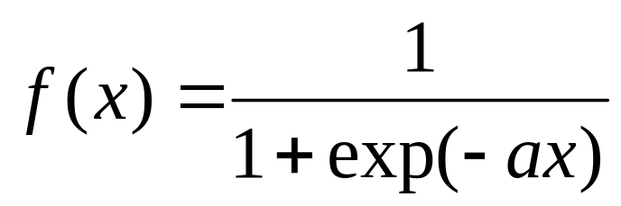
The Backpropagation Algorithm
Another difference is the activation function:
Perceptron algorithm uses unit activation function:
  This function is not differentiable at x=0.
Backpropagation uses logistic function:
Logistic function

Slide 15
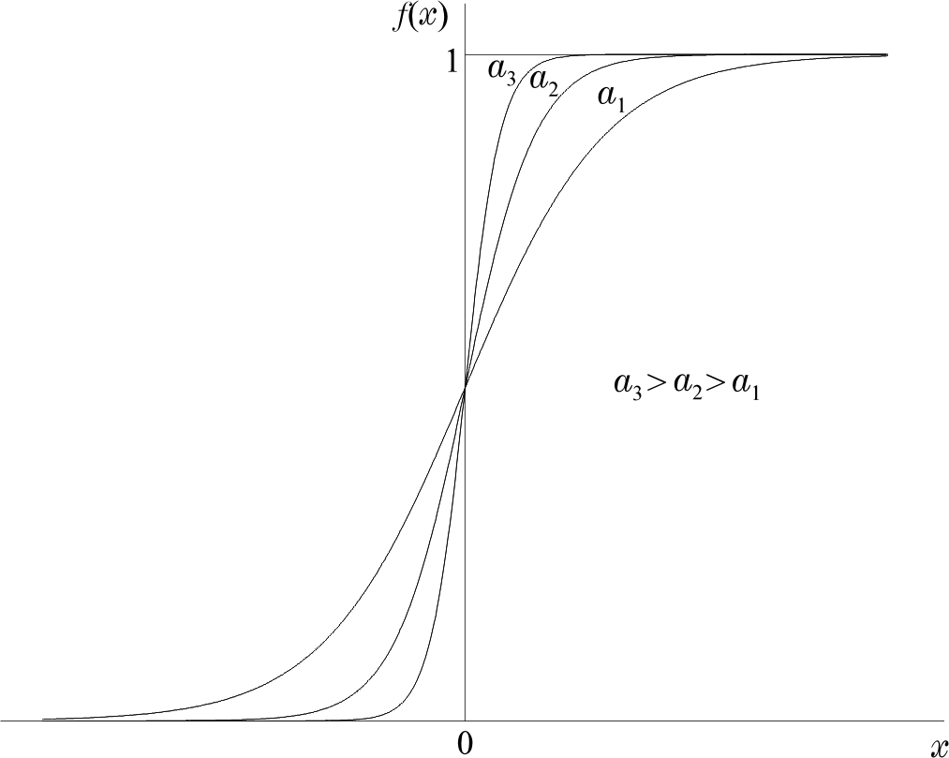
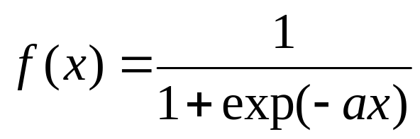
The Logistic function

Slide 16
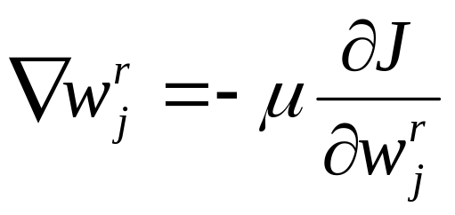
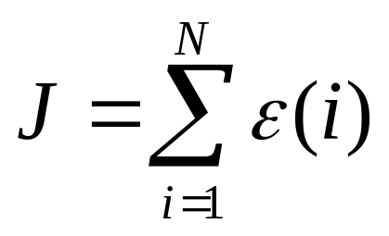
The Backpropagation Algorithm
Similar to perceptron algorithm: Backpropagation also iteratively updates weights
where,
and

Slide 17
Define the Terms
L layers of neurons
k_{r} neurons in r^{th} layer
k₀ nodes in the input layer = input feature dimension = l
k_{L} nodes in the output layer = output class dimension
1
2
k_{L}
(L-1)^{th}
Lth or

Slide 18
Define the Terms
Remember: The number of classes is more than 2, it is K_{L.}
Class value of a sample is no longer a single variable, rather it is a vector of k_{L} dimension.
1
2
k_{L}
(L-1)^{th}
Lth or

Slide 19
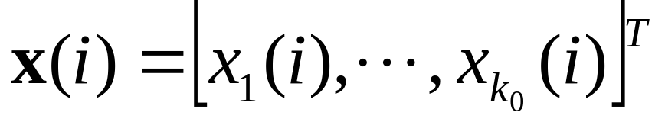
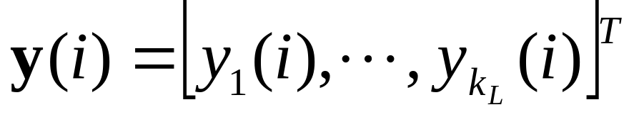
Define the Terms
N training samples: (x(i), y(i)), for i = 1, 2, 3, …, N
Features of ith training sample:
Class of ith training sample:
1
2
k_{L}
(L-1)^{th}
Lth or

Slide 20

Define the Terms
During training, apply i^{th} training vector x(i), and output is instead of y(i))
1
Apply x(i)
2
k_{L}
(L-1)^{th}
Lth or

Slide 21
Define the Terms
During training, apply i^{th} training vector x(i), and output is instead of y(i))
1
Apply x(i)
2
k_{L}
y(i) Actual
(L-1)^{th}
Lth or

Slide 22
Define the Terms
During training, apply i^{th} training vector x(i), and output is instead of y(i))
1
Apply x(i)
2
k_{L}
y(i) Actual
(L-1)^{th}
Error = ?
Lth or

Slide 23
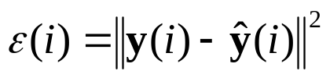
Define the Terms
During training, apply i^{th} training vector x(i), and output is instead of y(i))
1
Apply x(i)
2
k_{L}
y(i) Actual
(L-1)^{th}
Lth or

Slide 24


Define the Terms
During training, apply i^{th} training vector x(i), and output is instead of y(i))
Error for i^{th} vector:
Total Error:

Slide 25
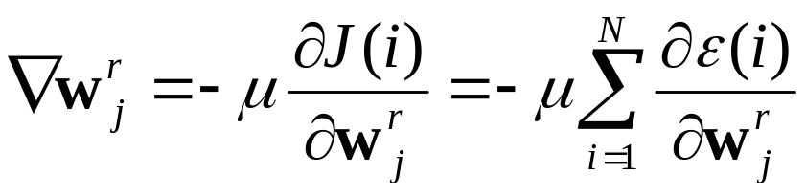
Define the Terms
We need to calculate

Slide 26
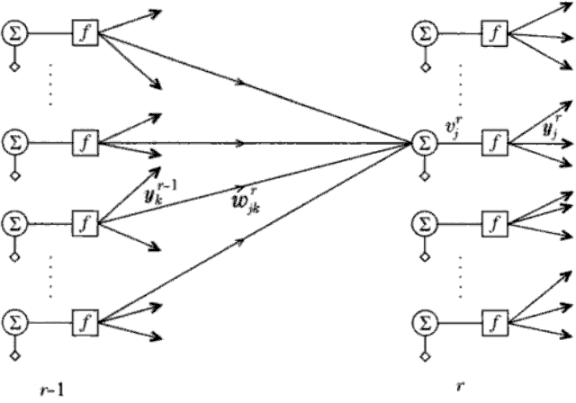
Define the Terms
We need to calculate
J depends on w^{r}_{j} and passes through v^{r}_{j}
y^{r}_{j}
v^{r}_{j}
w^{r}_{jk}
y_{k}^{r-1}

Slide 27

Define the Terms
y^{r}_{j}
v^{r}_{j}
w^{r}_{jk}
y_{k}^{r-1}

Slide 28

Define the Terms

Slide 29
Define the Terms

Slide 30
Define the Terms
Recall,

Slide 31
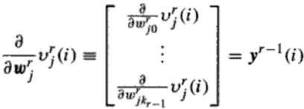
Define the Terms
Recall,
Therefore,

Slide 32
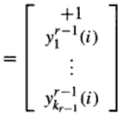
Define the Terms
Recall,
Therefore,

Slide 33
Define the Terms
Recall,
Therefore,

Slide 34

Define the Terms

Slide 35

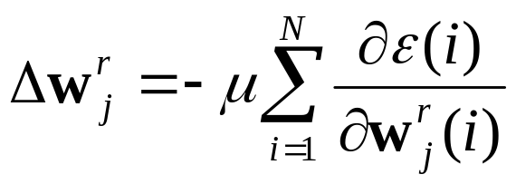
Define the Terms

Slide 36
Define the Terms

Slide 37
Define the Terms
1
2
k_{L}
(L-1)^{th}
Lth or

Slide 38
Define the Terms
1
2
k_{L}
(L-1)^{th}
Lth or
1. Find δ at Layer L

Slide 39
Define the Terms
1
2
k_{L}
(L-1)^{th}
Lth or
so on . . .
2. Find δ at Layer L-1
1. Find δ at Layer L

Slide 40
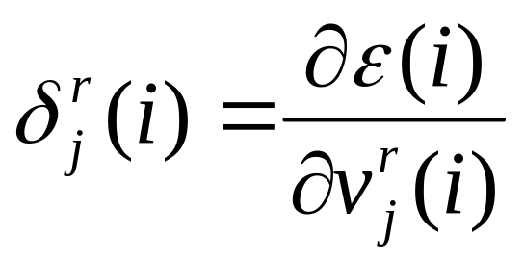
Define the Terms
Calculate

Slide 41

Define the Terms
Calculate
For r = L

Slide 42
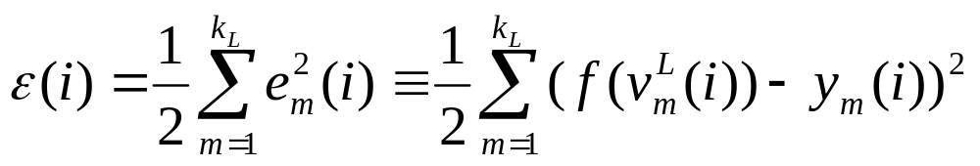
Define the Terms
Calculate
For r = L

Slide 43
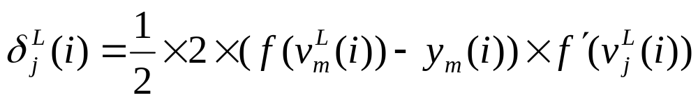
Define the Terms
Calculate
For r = L

Slide 44
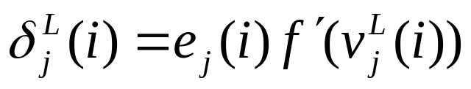
Define the Terms
Calculate
For r = L

Slide 45
Define the Terms
Calculate
For r = L

Slide 46
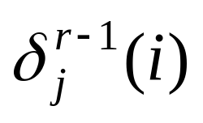
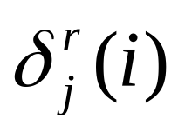
Define the Terms
For r < L
Calculate from

Slide 47
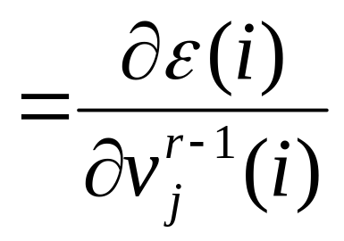
Define the Terms
For r < L
Calculate from
We know,

Slide 48


Define the Terms
We need to calculate,
However, influences all for k = 1, 2, 3, …, k_{r}

Slide 49
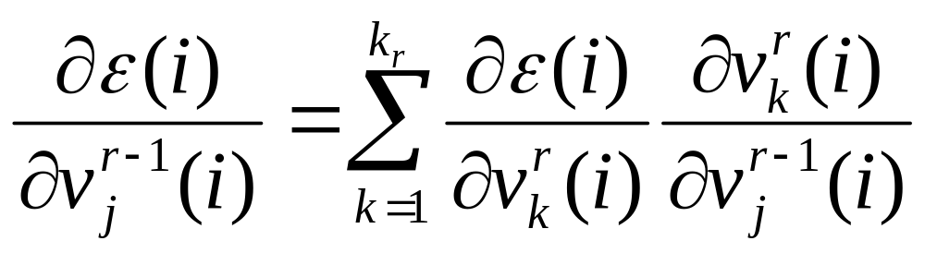
Define the Terms
We need to calculate,
However, influences all for k = 1, 2, 3, …, k_{r}
Therefore,

Slide 50
Define the Terms
For r < L
Calculate

Slide 51
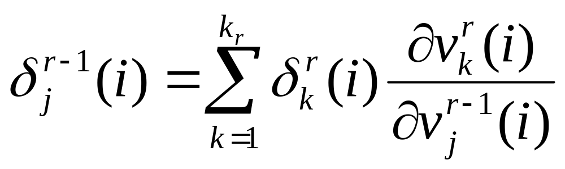
Define the Terms
For r < L
Calculate

Slide 52
Define the Terms
For r < L
Calculate

Slide 53
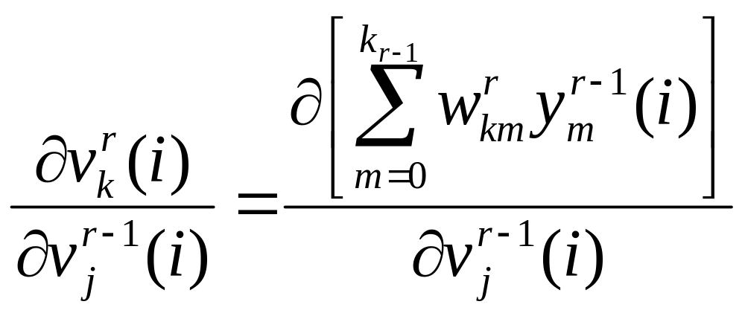
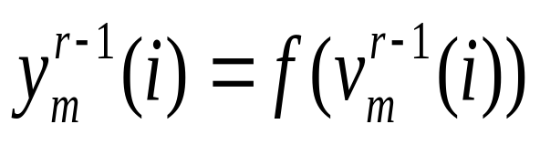
Define the Terms
where,

Slide 54
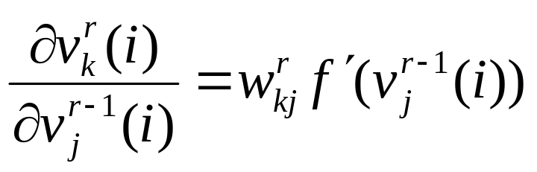
Define the Terms
where,
then,

Slide 55
Define the Terms

Slide 56
Define the Terms

Slide 57
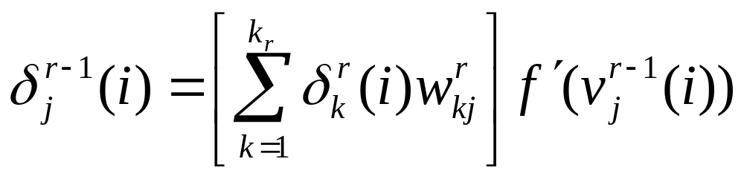
Define the Terms

Slide 58
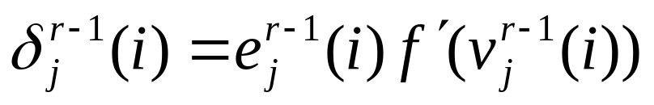
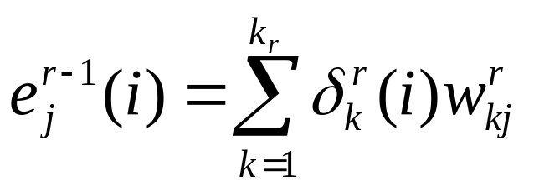
Define the Terms
where,

Slide 59
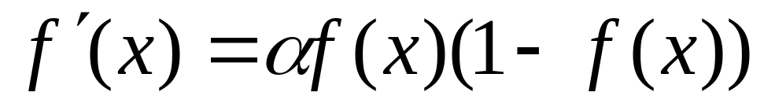
Define the Terms
Only remaining is the derivative of the logistic function:

Slide 60



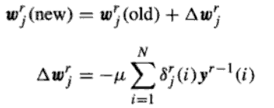
The Algorithm
Initialization:
  Start with small random weights
Forward Computations:
Backward Computation: and
Update weight:

